Slide 1

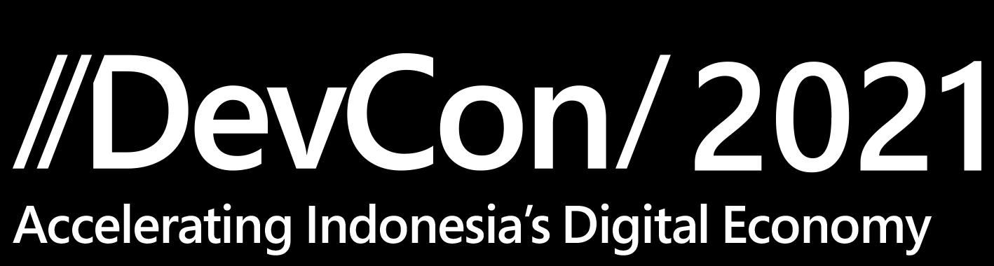

Slide 2
500M+ New Apps
in the next 5 years
IDC Research, Nov '19

Slide 3
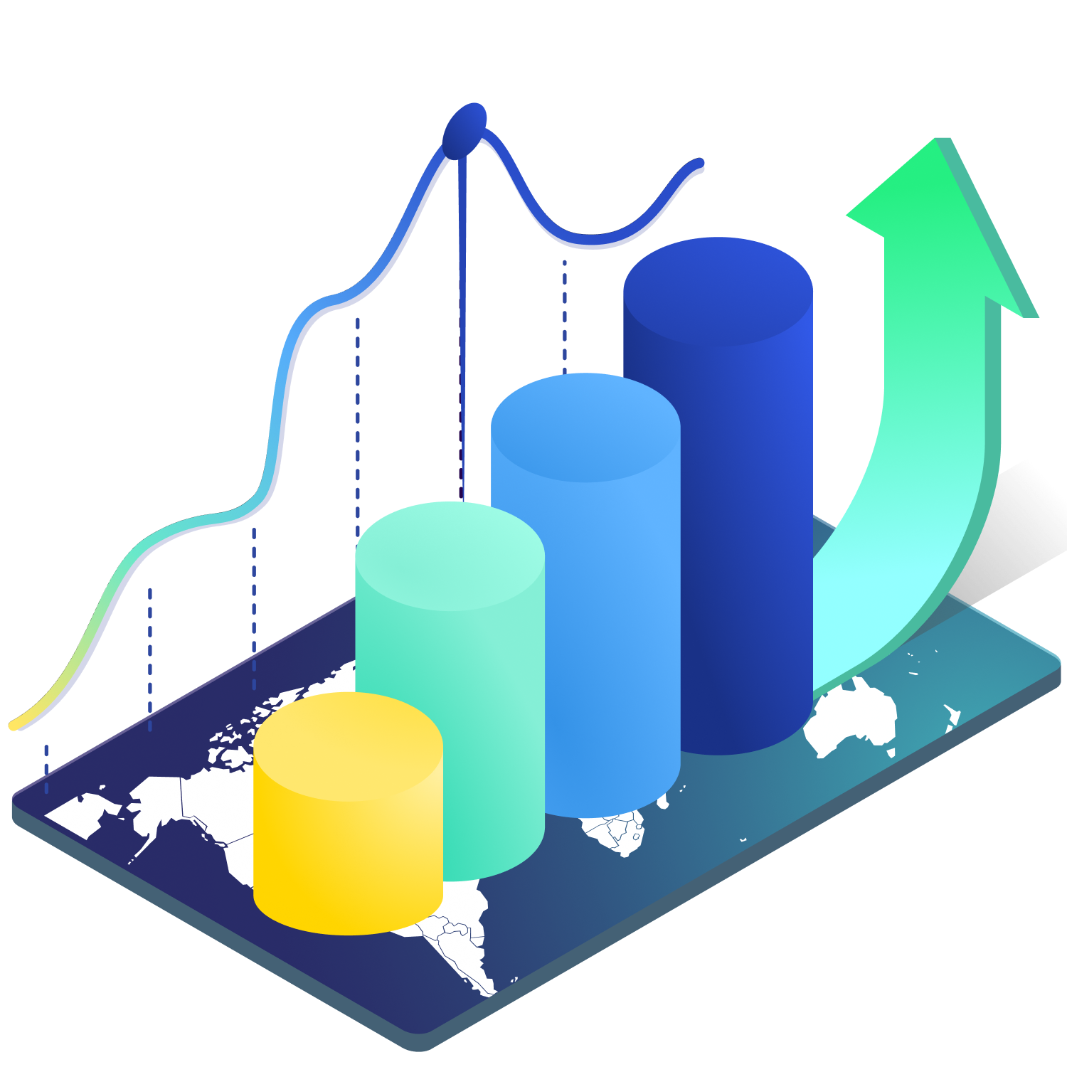

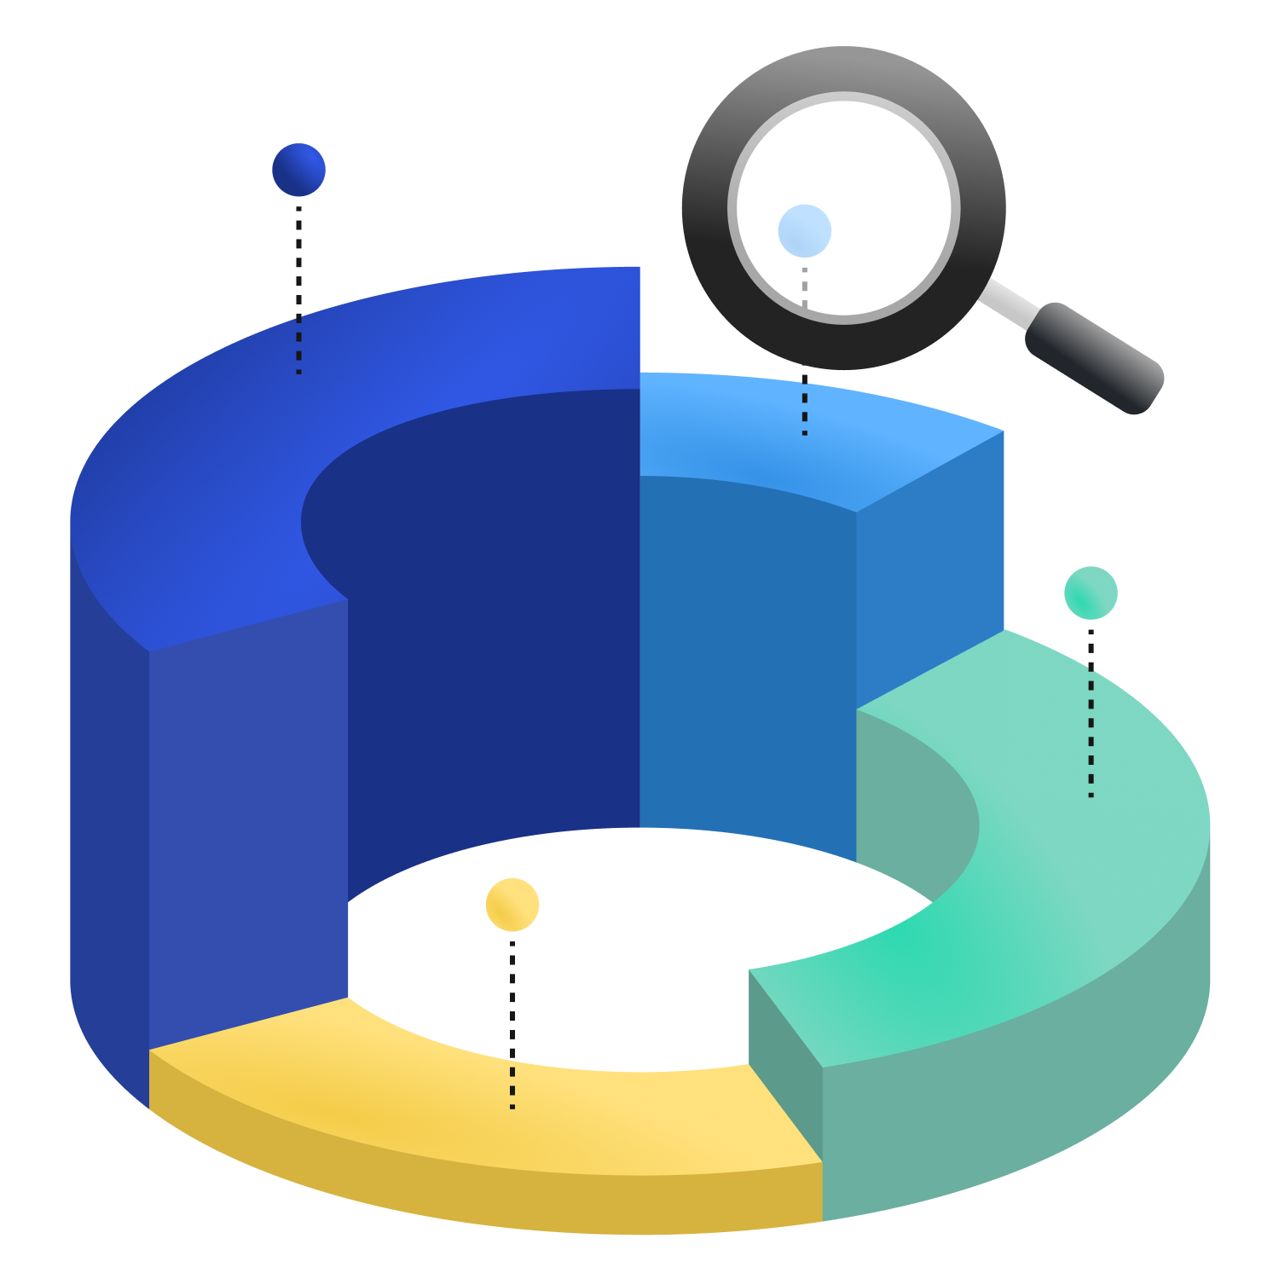

Ecosystem implements Power Platform to automate and streamlining business process effectively and efficiently starting from sales, project monitoring and recruitment

Slide 4
RECRUITMENT
PORTAL & MODEL DRIVEN APPLICATION

Slide 5
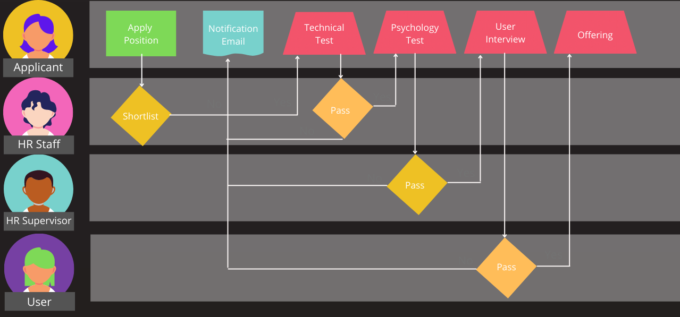

Slide 6
SALES & PROJECT MONITORING
MODEL DRIVEN APPLICATION

Slide 7
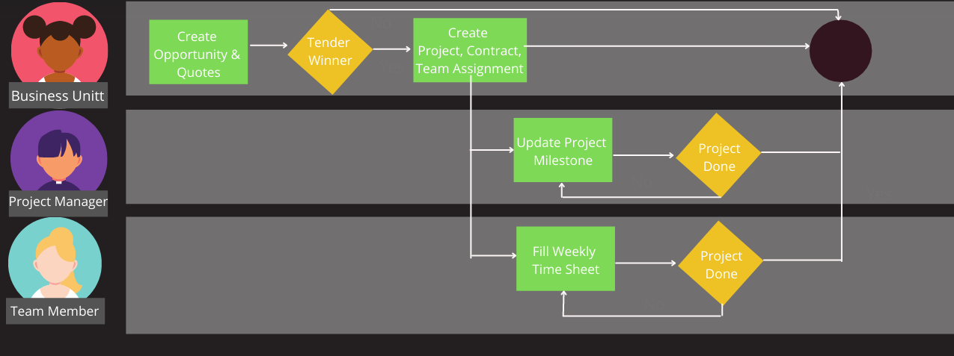

Slide 8


Slide 9
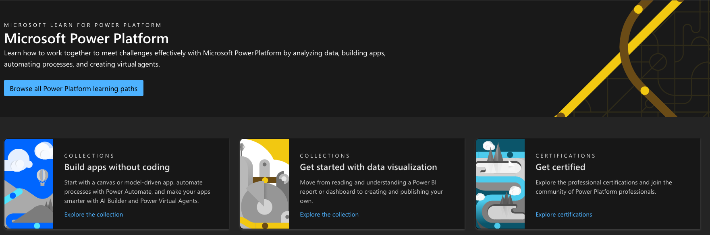
https://docs.microsoft.com/en-us/learn/powerplatform/

Slide 10
advisory@ecomindo.com

Slide 11
Thank you

